Slide 1
Predicting the Forest Through the Trees:
An Analysis of Supervised Learning Methods for Multi-class Classification
W207 - Section 1 - Summer 2022
Titilayo Agbabiaka, Hanna Grossman, Jonathan Whiteley

Slide 2
Agenda
Kaggle Competition & Dataset Overview
Context
EDA
Modeling:
Baseline models: Multiclass Logistic Regression, KNN
Advanced models: Random Forest, Gradient Boosting, XGBoost, Neural Network
Findings & Final Thoughts
Notes:
Hanna, Jonathan and I collaborated on this project to determine the best Machine Learning Method to classify forest cover types based on a given input of attributes pertaining to the surrounding environment. This analysis looks at 5 different supervised ML approaches in addition to their respective specifications and performances. Our end goal was to select the best performing model to submit to the kaggle competition, measure its performance against other high performing methods, and conclude which ML algorithm is best suited for the given task.
Agenda (Titilayo)
Dataset Overview (Titilayo)
Context (Jon)
EDA (Jon)
Modeling:
Baseline models: Multiclass Logistic Regression, KNN
Advanced models: Random Forest, Gradient Boosting, XGBoost, Neural Network
Findings & Final Thoughts (Jon)

Slide 3
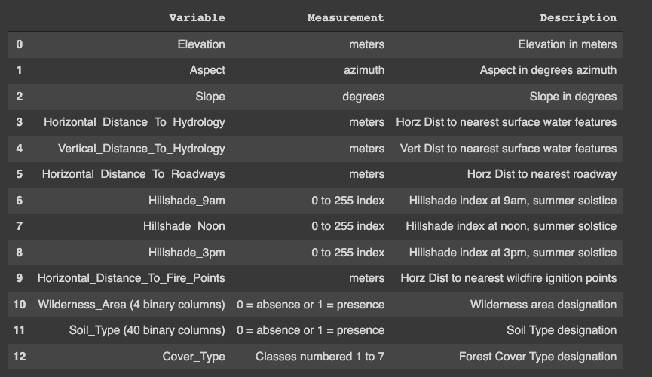
Dataset Overview
Labels:
1 : Spruce/Fir
2 : Lodgepole Pine
3 : Ponderosa Pine
4 : Cottonwood/Willow
5 : Aspen
6 : Douglas-fir
7 : Krummholz
Each observation = 30 x 30 meter cell labeled by USFS
Study area includes four wilderness areas in Roosevelt National Forest (Northern Colorado)
Training set (15,120 observations); test set (565,892 observations)
Notes:
This area was chosen for the study because:
minimal human-caused disturbances
so forest cover types are more a result of ecological processes rather than forest management practices.

Slide 4
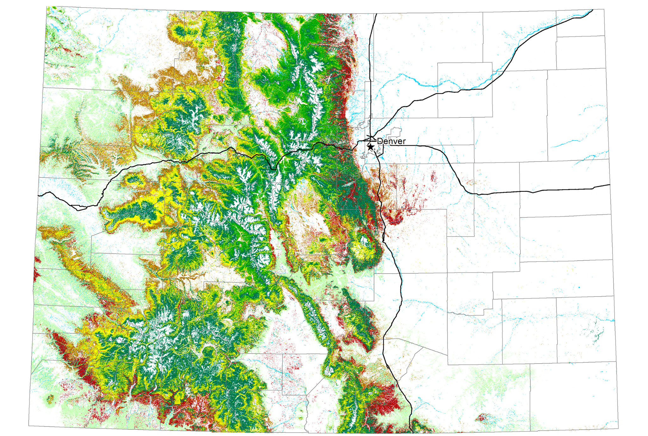
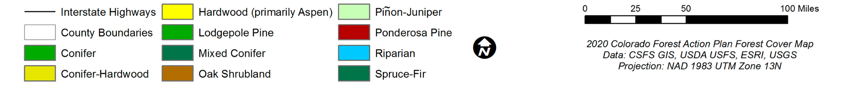

Slide 5
Context
The Challenge:
Wildfire is a common occurrence in the Northern Rockies
Knowing forest type is important for anticipating how fires will spread in an area and how forest succession will trend with and without management actions ¹.
Multi-class classification problem
The Goal:
Predict the forest cover type from cartographic variables obtained from the US Geological Survey and US Forest Service (USFS)
The Measure of Success:
Accuracy - accounts for all misclassification
Our classification problem is not a largely imbalanced classification problem so not as much need to augment with precision or recall.
¹ Hood, Sharon; Abrahamson, Ilana; and Cansler, C. Alina. 2018. Fire resistance and regeneration characteristics of Northern Rockies tree species. In: Fire Effects Information System, [Online]. U.S. Department of Agriculture, Forest Service, Rocky Mountain Research Station, Missoula Fire Sciences Laboratory (Producer). Available: https://www.fs.fed.us/database/feis/pdfs/other/FireResistRegen.html.
Notes:
Let’s better understand the task at hand here and why we feel it is important
Most of you know Wildfire is an all too common occurrence - esp N Colorado and Calif.
Having an accurate picture of which areas contain which forest type is CRITICAL for fire mitigation practices and for resource allocation.
Many tree species have adaptations to survive and regenerate after fire
As you can see from the previous image, there is a TON of overlap of tree types in certain areas…leading to a multi class classification problem
SO our goal is to predict forest cover type and do so with a high degree of accuracy
Accuracy - important because incorrectly classifying cover types could be detrimental to the environmental care initiatives of the US Forest Service (USFS).

Slide 6
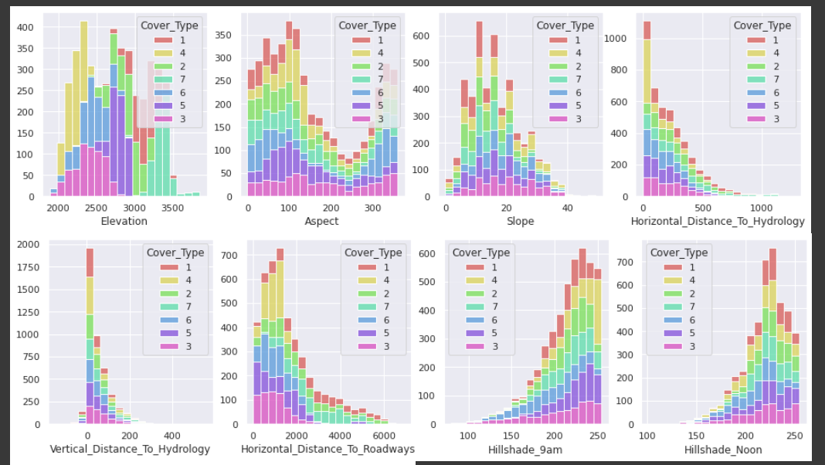
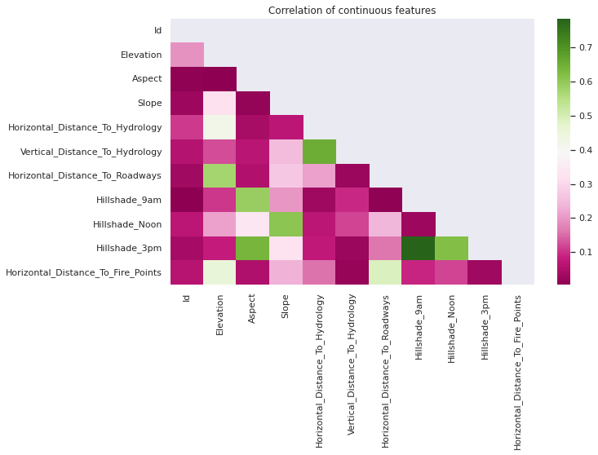
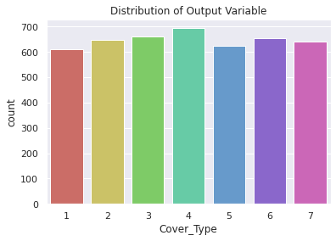
EDA
Histogram/Scatterplot Matrix:
Scales differ across continuous variables.
Wilderness_Area and Soil_Type factors are binary.
Check for Missing Values
No missing values in this dataset
Distribution of Output Variable
Relatively even count of each tree type in our train set.
Correlation Matrix
Hillshades at different times of day & Slope
Horizontal & Vertical distance to hydrology were all moderately correlated
Notes:
EDA:
With our task identified, we next set out to better understand our data
Through the approaches listed here:
Check scale, relationships between features
to help ground expectations for our more advanced models, Titilayo & Hanna will now walk through our Baseline models

Slide 7
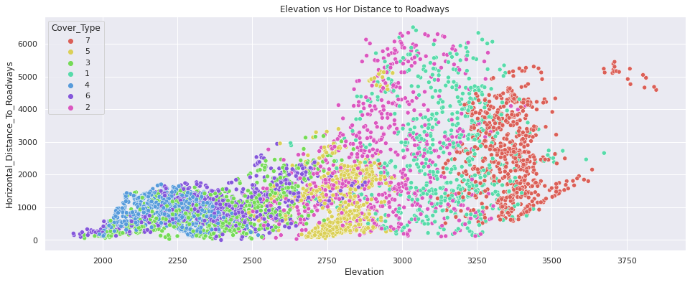
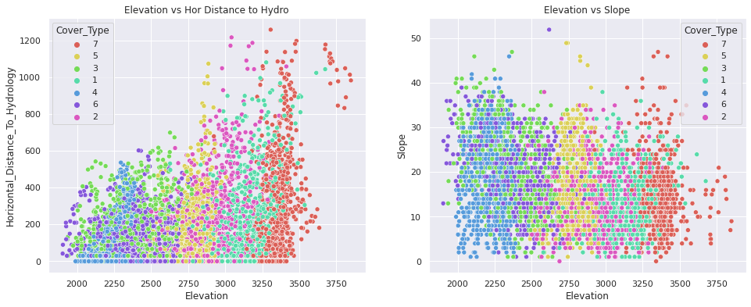

Slide 8
Baseline Models
Notes:
Help ground expectations for modeling experiments.
A baseline should be a simple system that is reasonably difficult to beat, thus helping us calibrate evaluation scores from our models.

Slide 9
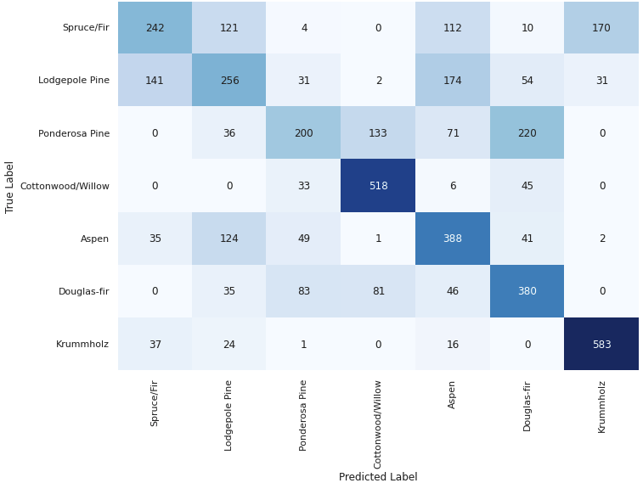
Multiclass Logistic Regression
Keras
SKlearn
Default Parameters
Multi_class = ‘ovr’
Validation Accuracy: 56.6%

Slide 10
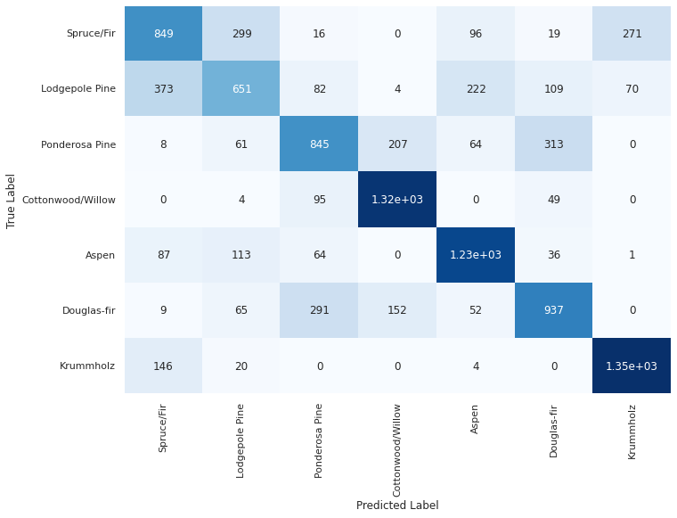
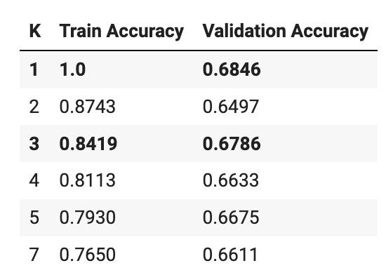
KNN
Sklearn KNeighborsClassifier
Normalized data
Tested a variety of k values:
k = 1 and k = 3 performed best. We chose k = 3 to prevent from overfitting that may occur with only having one nearest neighbor
Validation Accuracy: 67.9%
Notes:
We can see that our model was fairly consistent in identifying labels 4, 5, and 7 forest types.
It struggled the most identifying observations with an actual Label of 2, misclassifying many as either Label 1 or Label 5.
In fact in predicting observations with an actual Label of 1 or 2, it mixed them up about 30% of the time.

Slide 11
Advanced Models

Slide 12
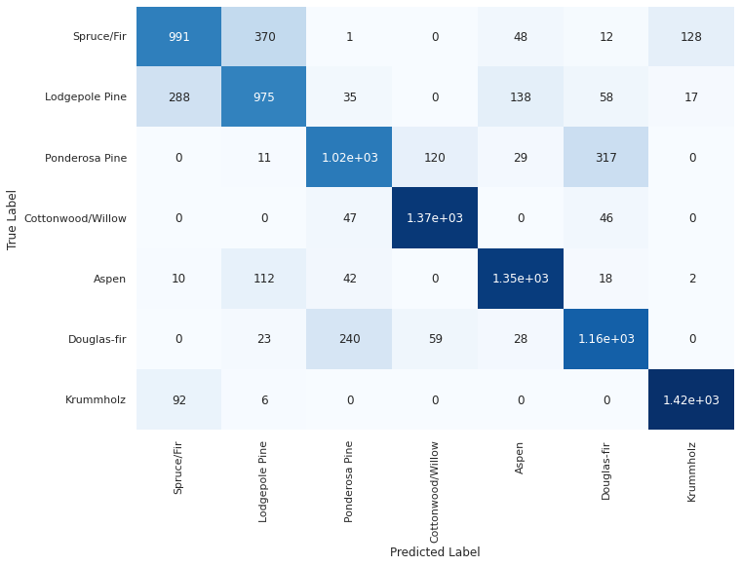
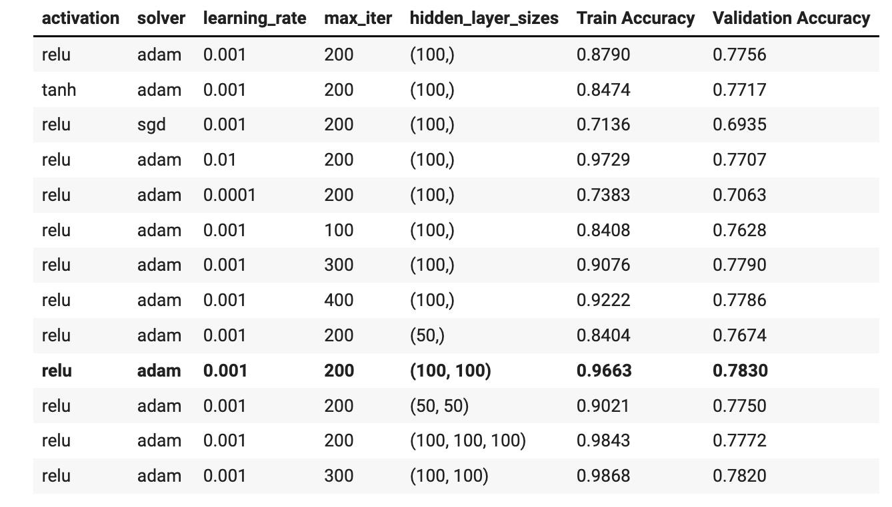
#1: Neural Network
Sklearn MLPClassifier
Normalized data
Best Performing Parameters:
Activation: relu
Activation function for the hidden layer
Solver: adam
The solver for weight optimization
Learning_rate: 0.001
The step-size for updating weights
Validation Accuracy: 78.3%
Max_iter: 200
The solver will iterate until convergence or to this number of iterations
Hidden_layer_sizes: (100, 100)
The number of neurons in each hidden layer
Notes:
We can see that our model was fairly consistent in identifying labels 4, 5, and 7 forest types.
It struggled the most identifying observations with an actual Label of 2, misclassifying many as either Label 1 or Label 5.
In fact in predicting observations with an actual Label of 1 or 2, it mixed them up about 30% of the time.

Slide 13

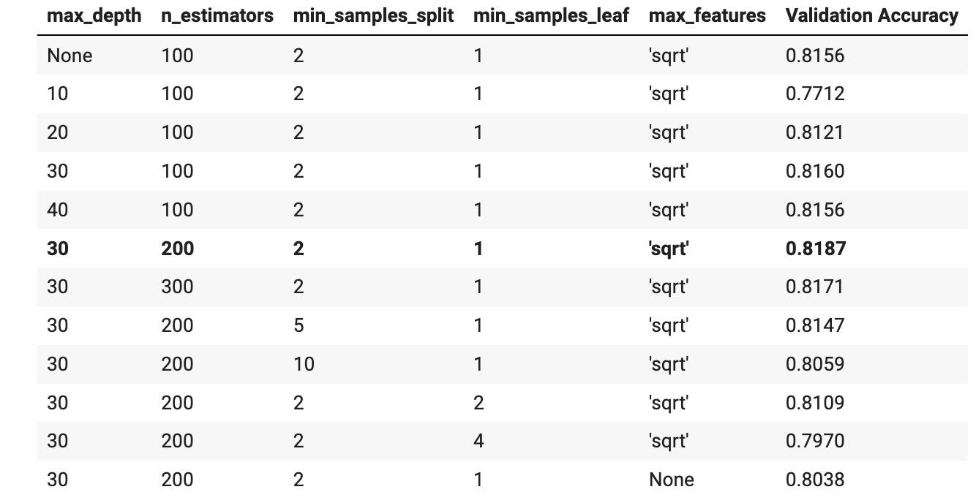
#2: Random Forest
Sklearn RandomForestClassifier
Best Performing Parameters:
max_depth: 30
Maximum depth of a tree. Increasing this value will make the model more complex and more likely to overfit.
n_estimators: 200
Number of trees in the forest.
max_features: ‘sqrt’
The number of features to consider when looking for the best split.
Validation Accuracy: 81.9%
Notes:
We can see that our model was fairly consistent in identifying labels 4, 5, and 7 forest types.
It struggled the most identifying observations with an actual Label of 2, misclassifying many as either Label 1 or Label 5.
In fact in predicting observations with an actual Label of 1 or 2, it mixed them up about 30% of the time.

Slide 14
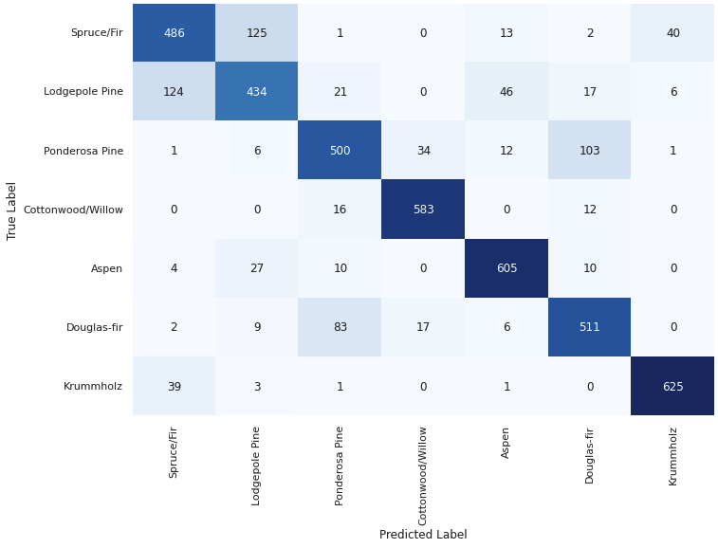
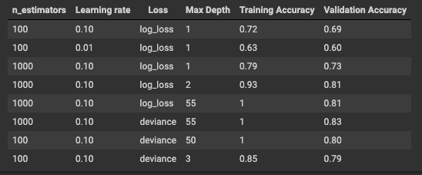
#3: Gradient Boosting Classifier
Best Performing Parameters:
Learning Rate = 0.10
N estimators = 1000
Max depth = 55
Loss Function = ‘Deviance’
Accuracy
Validation Accuracy = 83%
Notes:
Our next Machine Learning implementation was a Gradient boosting classifier.

Slide 15
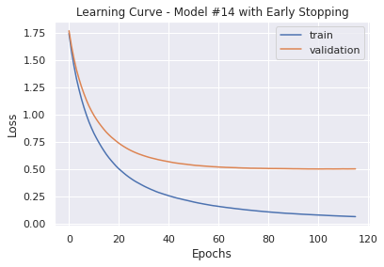
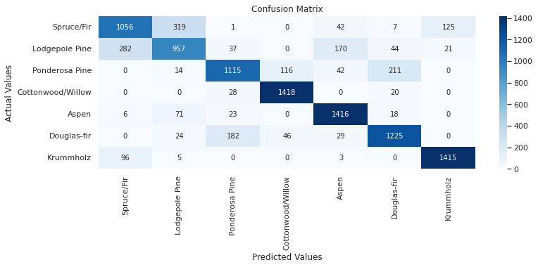
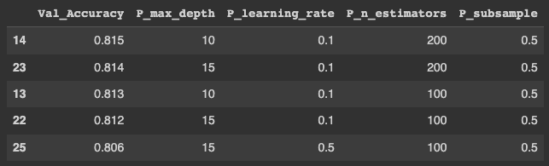
#4: XGBoost
Ensemble method, optimized distributed gradient boosting library
Experimented with Early Stopping to Mitigate Overfitting
Validation Accuracy: 81.5%
Parameters Tuned:
max_depth : Maximum depth of a tree. Increasing this value will make the model more complex and more likely to overfit.
learning_rate: Step size shrinkage used in update.
n_estimators: Number of gradient boosted trees. Equivalent to number of boosting rounds.
subsample: Subsample ratio of the training instances. 0.5 = randomly sample half of the training data prior to growing trees to prevent overfitting.
Notes:
XGBoost:
The library leveraged for model #4 was XGBoost which uses a similar approach as gradient boosting, but with a slightly different implementation ment to take advantage of a distributed framework
You can see off to the right, the parameters focused on in terms of tuning our XGBoost model.
Our best model led to Validation accuracy of 81.5%
We experimented with early stopping
It appears that not much progress was being made in terms of validation loss after epoch 100 or so. We adjusted XGBoost's early_stopping_rounds parameter. This will allow us to specify a window of the number of epochs over which no improvement is observed (10% here).

Slide 16
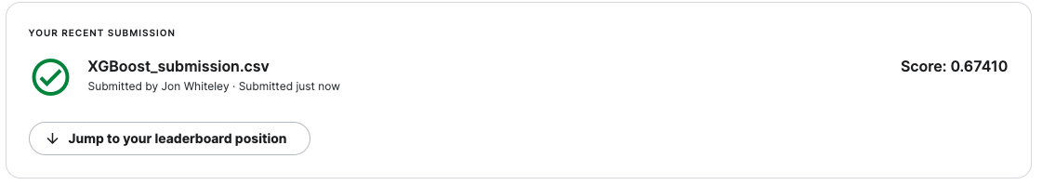
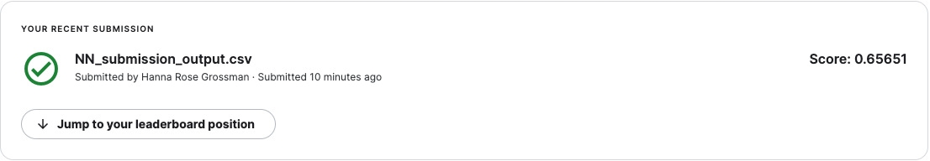
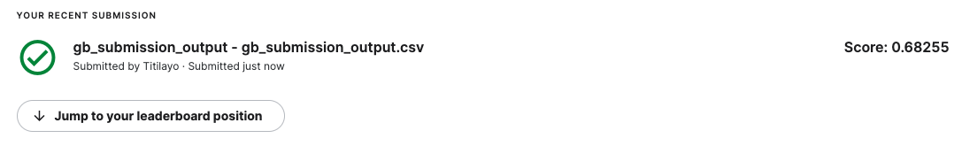
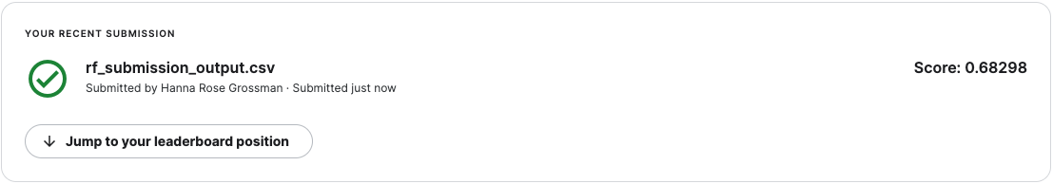
Findings & Final Thoughts
Models results submitted to Kaggle (scores below)
Test accuracy was significantly lower than Validation
Next Steps (if more time/resources)
Explore additional methods to prevent overfitting
Further hyperparameter tuning with GridSearch
Additional feature engineering & selection
Notes:
This leads nicely into our FINDINGS summarization:
We submitted all 4 advanced models to Kaggle and were a bit disappointed that we barely beat our baseline, with the Random Forest model performing the best
As expected, these approaches were prone to overfitting despite our initial tuning
With more team we would like to explore the following next steps…
Titilayo experimented a big with feature selection, care to share your thoughts there and any final thoughts?

Slide 17
Thank You!

